Slide 1
2d SNAKE GAME
By
- K.Shirisha (2451-16-733-052)
- S.Saishashank(2451-16-733-301)

Slide 2
Abstract
The project’s aim was to create a 2D snake game. This snake keeps on growing with the consumption of feed. The game ends with the snake either colliding with itself or with the window. This game is implemented in C language including standard glut library.

Slide 3
introduction
The following is an example game written in C using glut based on the game called ‘snake’ which has been re-emerged in recent years on mobile phones. It isn’t the greatest game, but it does give you an idea of what you can achieve with OpenGL, and perhaps the basis by which to extend the principles and create more interesting games of your own.
Let’s talk about game and its controls to move the snake use
‘UP ARROW’ for UP,
‘DOWN ARROW’ for DOWN,
‘LEFT ARROW’ for LEFT,
‘RIGHT ARROW’ for RIGHT.

Slide 4
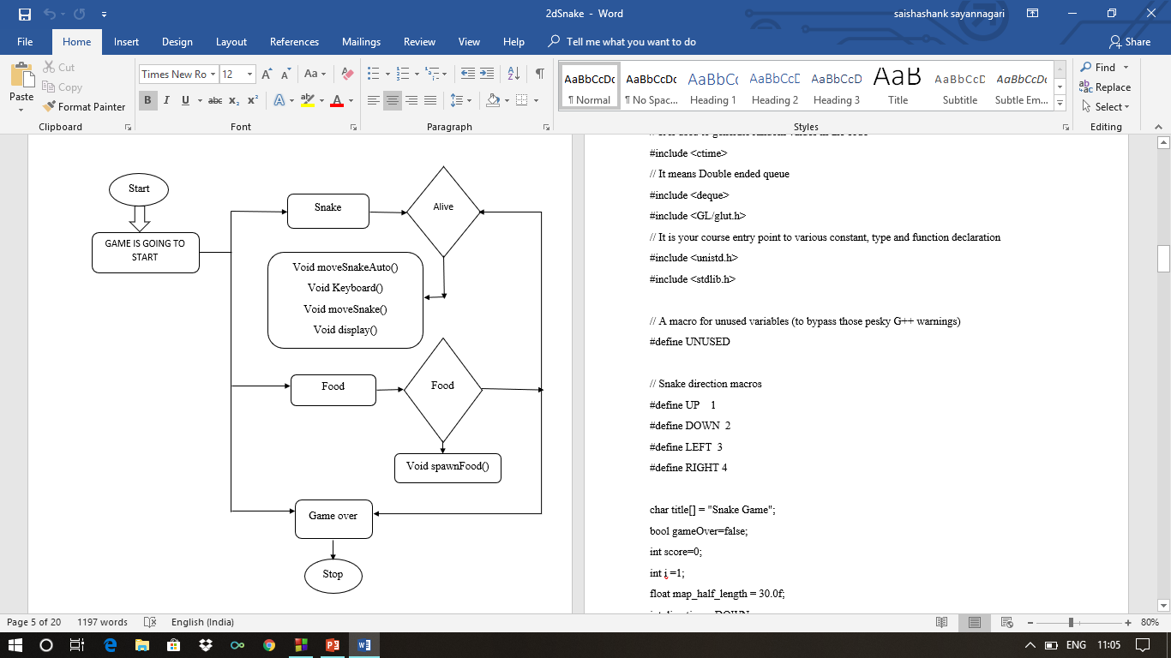
Flow chart

Slide 5
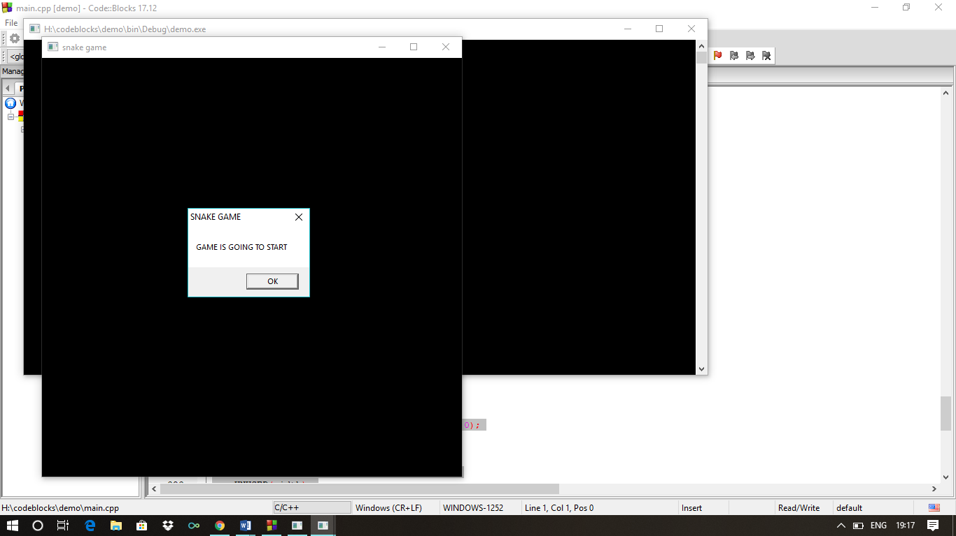
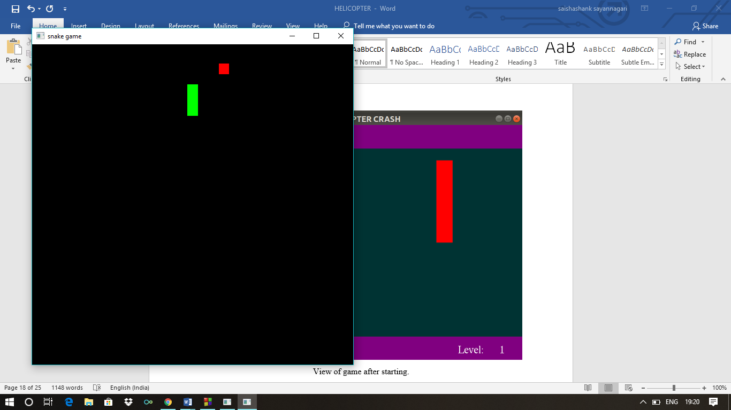
Screen shots
Start of the game and Welcome screen
View of the game after starting

Slide 6
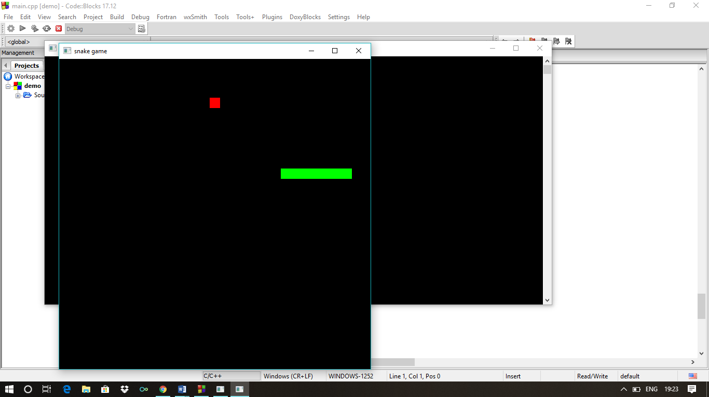
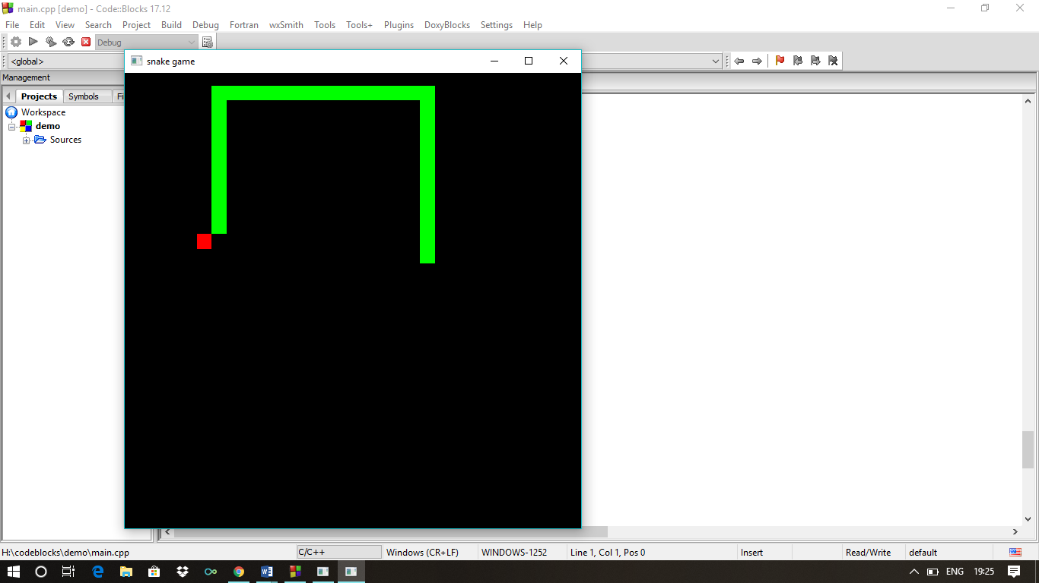
Size of snake increases by consuming food

Slide 7
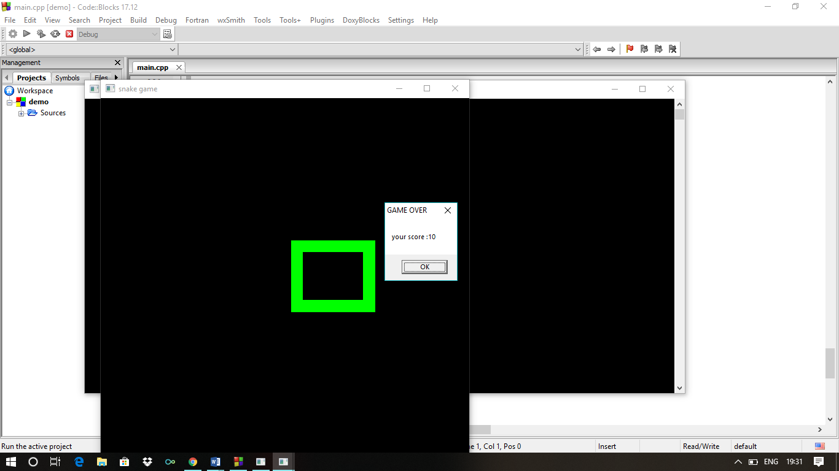
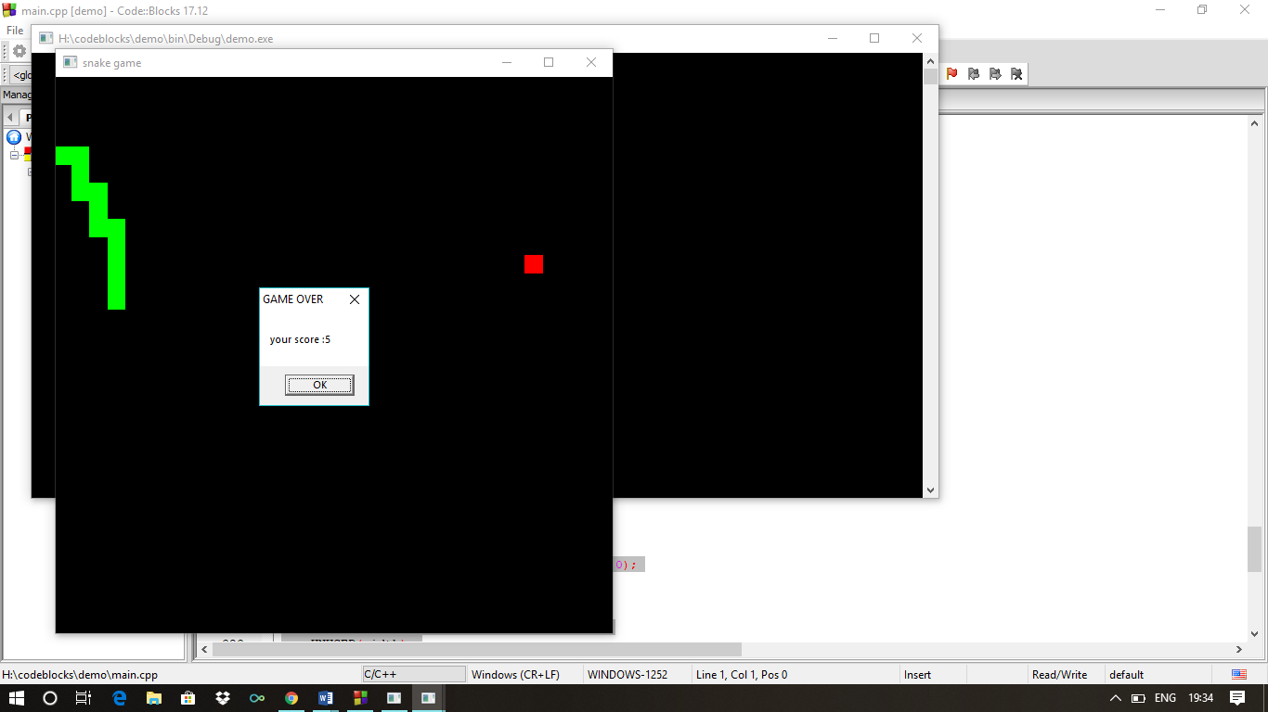
Snake colliding itself and Game over
Snake colliding with window and Game over

Slide 8
References
https://www.opengl.org/resources/libraries/glut
https://www.github.com
https://www.khronos.org/registry/OpenGL-Refpages/gl2.1/xhtml/glOrtho.xml

Slide 9
Thank you

